Slide 1
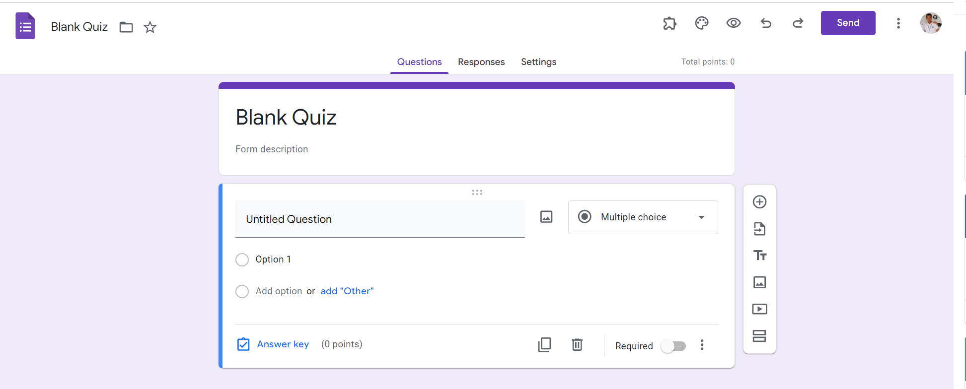
Identify root components of website below

Slide 2
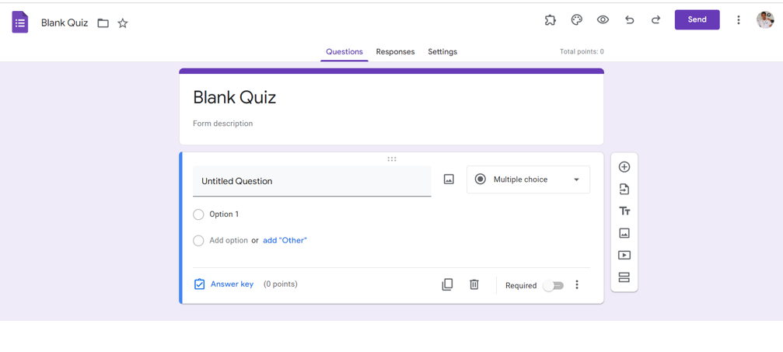
Identify the div structure for root
Flex:0
Nav
Flex:0
Header
Flex:1
Container

Slide 3
Identify the div structure for Navigation
Flex:0
Nav-top
Flex:0
Nav-bottom

Slide 4
Identify the div structure for Nav-top
Nav-top
Nav-top
Nav-left
Nav-right
icon
text
icon
icon
icon
icon
icon
icon
icon
button
icon
icon
display: flex;
justify-content : flex-start: flex-start
display: flex;
justify-content : flex-end: flex-start

Slide 5
Identify the div structure for Nav-bottom
Flex:0
Nav-bottom
Nav-bottom
Nav-left1
Nav-right1
text
text
text
text
display: flex;
justify-content : flex-end flex-start
display: flex;
justify-content : center flex-start

Slide 6

Identify the div structure for Header
Heading1
p
justify-content : start

Slide 7
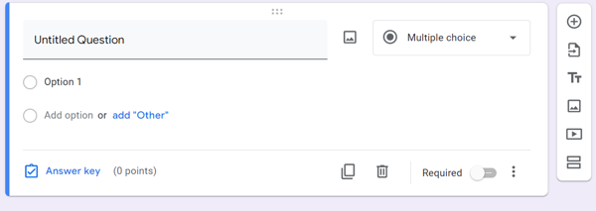
Identify the div structure for Container
Container-Left
Container-Right
Display: flex

Slide 8
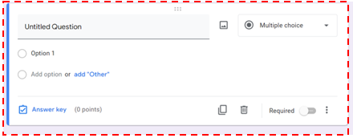
Identify the div structure for Container-Left
Container-Left
Containerleft-header
Containerleft-body
Containerleft-footer

Slide 9
Identify the div structure for Container-Left
Container-Left
Input
Icon
bottom
Icon
text
Icon
text
Icon
Label
text
Icon
Icon
text
Icon
Icon

Slide 10

Identify the div structure for Container-Right
Icon
Icon
Icon
Icon
Icon
Icon
Flex-direction : column

